Slide 1


PACKING TRACKING SOLUTION
2020
PROJECT
IT DEPARTMENT
Moving Forward To Industry 4.0

Slide 2
1.0 Introduction:
Packaging inventory management system for Plastictecnic (M) Sdn Bhd – Bangi branch
2.0 Objective:
To record individual pallet, storage bin & metal cage’s status
Make every pallet, storage bin & metal cage traceability
Moving Forward To Industry 4.0

Slide 3
System Features
PLASTICTECNIC | CUSTOMER
User Login And Registration | User Login
Packaging Registration - Pallets - Bin/Boxes - Cages | View Summary
Monitor & Track Movement of Packaging ( Log )
Summary Report
Scanning of Packaging to store the information.
Moving Forward To Industry 4.0

Slide 4
Projects Team
IT | Bangi Team
Kelvin - Infra | Saberi – Warehouse
Hazim - Programmer | Foo - Sales
Moving Forward To Industry 4.0

Slide 5
Projects Team Line
No | Task | PIC | JULY |  |  |  | AUGUST |  |  |  | SEPTEMBER
Pallet Inventory System |  |  | W1 | W2 | W3 | W4 | W5 | W6 | W7 | W8 | W9 | W10 | W11 | W12
1 | Project kick off meeting | All
2 | Hardware Preparation | IT
3 | Development | IT
4 | UAT | IT & User
5 | User Training | IT
6 | Go Live & Test Run | IT & User
7 | Documentation
Moving Forward To Industry 4.0

Slide 6
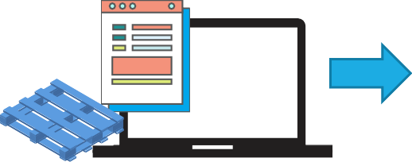











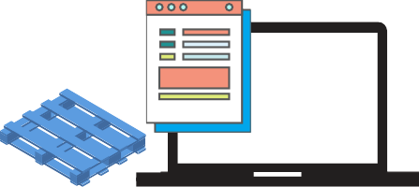







Process Flow
Inventory
Scan QR code sticker
Confirm storage picking & Print acknowledge
Deliver finish good to customer with storage boxes
Check and verify by customer
Customer send
back storage boxes
Inventory auto updated
Confirm storage
boxes receiving
Scan QR code sticker
Moving Forward To Industry 4.0

Slide 7

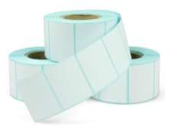

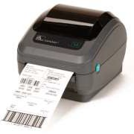
Hardware Requirement
Tablet PDA
Label Printer
(Can use Warehouse or Wawa printer)
Label Sticker + Ribbon
Access Point
Moving Forward To Industry 4.0

Slide 8
Project Cost Estimate
Project Cost Estimate
No | Item | Quantity | Unit Price | Total
Hardware
1 | Tablet / PDA | 2 | 400 | 800
2 | Access Point (Tenda | 1 | 280 | 280
3 | Label Sticker - Cenic yupo 100x50mm x1000 pcs | 50 | 34 | 1700
4 | Label Sticker ribbon - resin 110x300mm | 10 | 66 | 660
5 | Software Module for Development (AWS https) subscription | 2 months | 160 | 360
 | Total
 | Grand Total | 3,800.00
Moving Forward To Industry 4.0

Slide 9
3.0 Planning
Phase 1
- Confirm workflow
- Prepare Hardware
Phase 2
- Prepare sticker and put to on packing
- Perform UAT
- User training
Phase 3
- Go Live
- Design and develop system
- Introduction to related party
- Network infra installation
Moving Forward To Industry 4.0

Slide 10
Q & A
Moving Forward To Industry 4.0

